Slide 1
CCDI Training – Day 2
Computer Vision
Image Classification
11 July 2023

Slide 2
Outline
Terms
Define Computer Vision
State Some Applications of Computer Vision
Differentiate Between Image Classification and Objects Detection
Explain the Convolutional Neural Network (CNN)
Use CNN Algorithms
Create an Image Classification program
Computer Vision
Image Classification
Object Detection
Convolutional Neural Networks (CNN)
Kernel (Filters), Pooling, Stride, Flatten
Jupyter Notebook
01
02
03
04
05
06

Slide 3


Computer Vision
Computer Vision (CV) is a field of artificial intelligence (AI) that enables computers to derive meaningful information from images, videos and other visual inputs.

Slide 4


Computer Vision
Image search

Slide 5


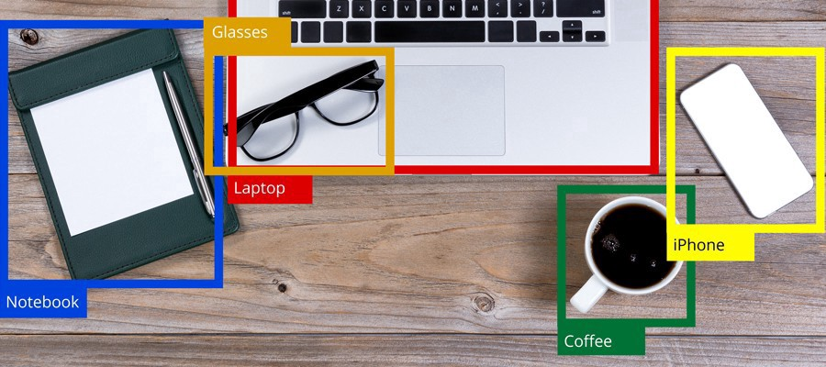
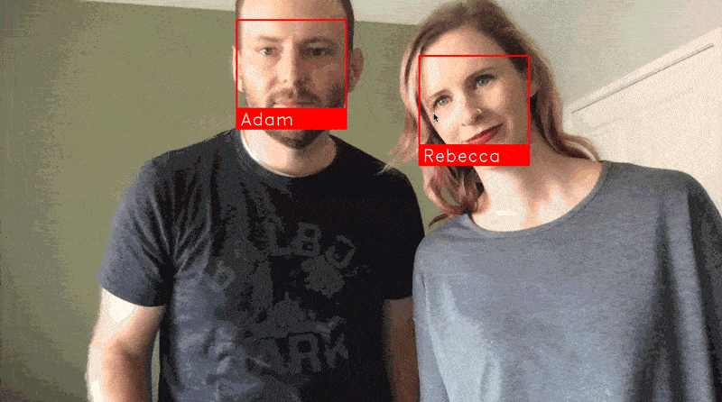
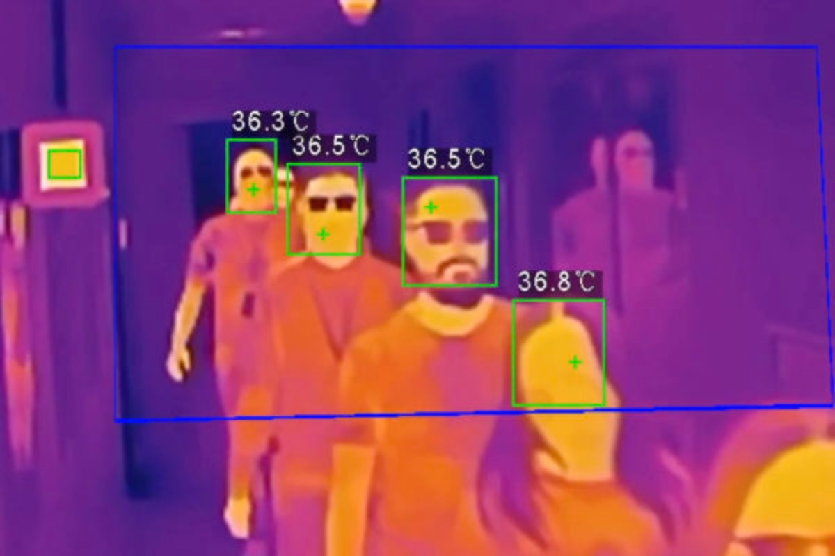
Computer Vision
Some applications of CV are
1) Facial recognition 2) OCR 3) Object detection 4) Security systems 5) Image Classification

Slide 6
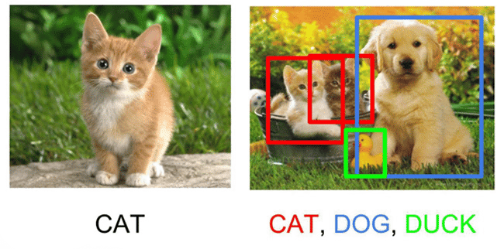

Image Classification vs Object Detection
What is image classification?
How is it different than object detection?

Slide 7
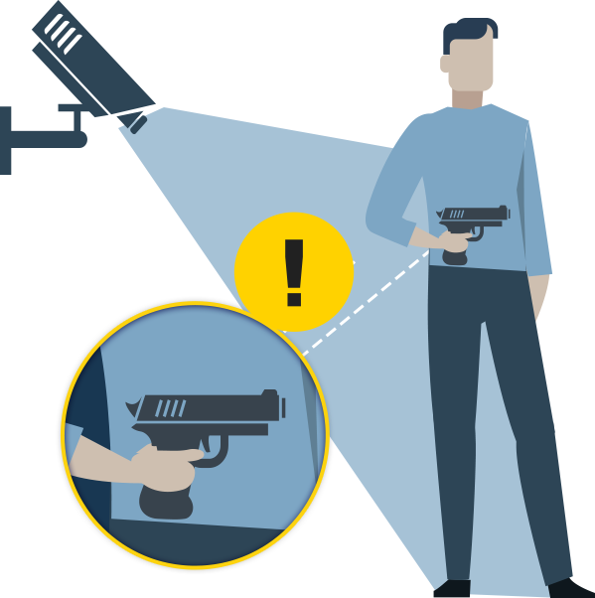
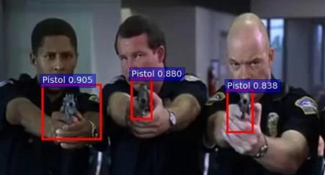
Other Applications of Object Detection
Surveillance camera

Slide 8
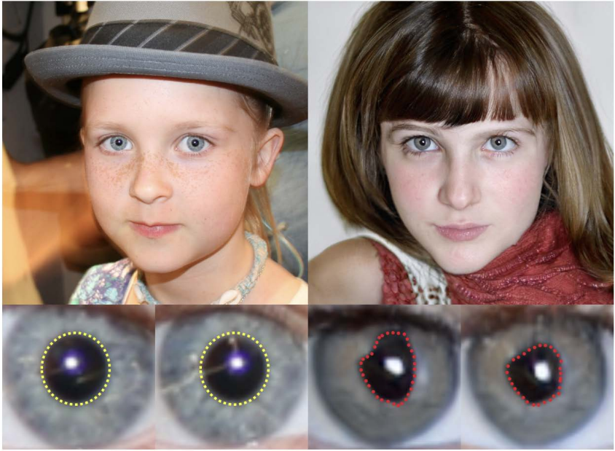
Modern Applications of CV
Fake images detection

Slide 9

Modern Applications of CV
Modern Applications of CV
Fake images detection

Slide 10
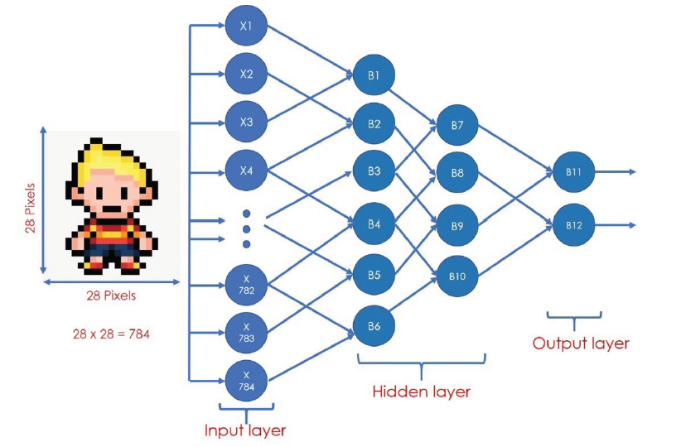
Back propagation – NN Training

Slide 11
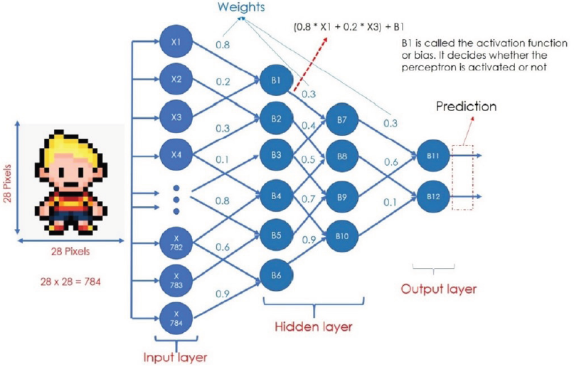
Back propagation – NN Training

Slide 12
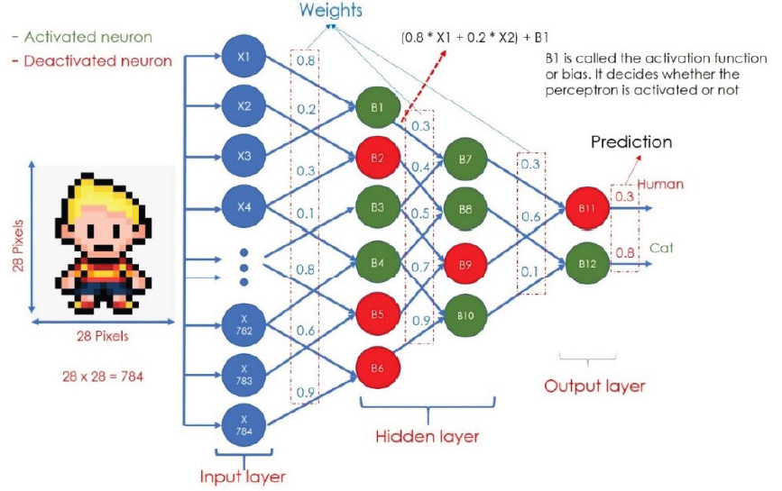
Back propagation – NN Training

Slide 13
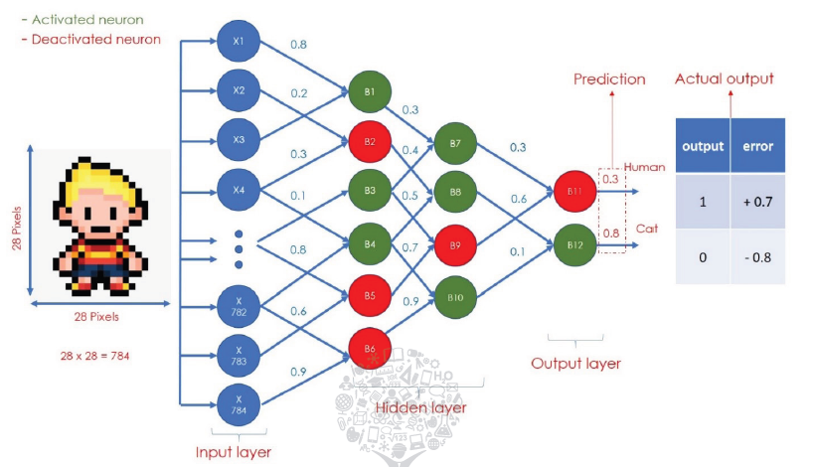
Back propagation – NN Training

Slide 14
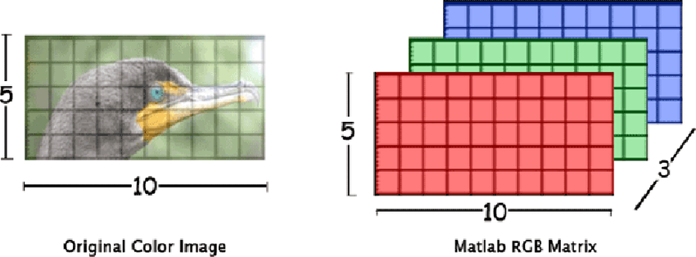
RGB images

Slide 15
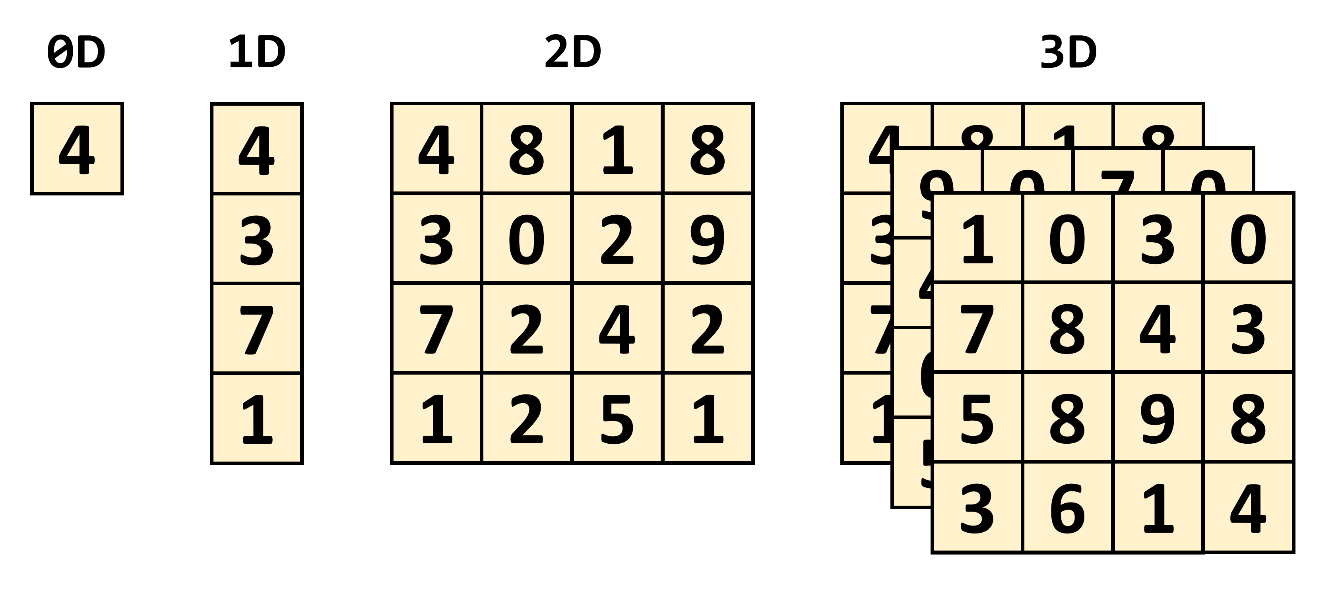
Tensor
Scalar
Vector
Matrix
Tensor

Slide 16
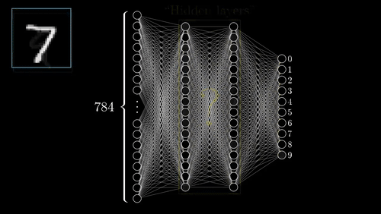
Computer Vision
28x28 image → 784 Vector
784 values are fed to NN
Weights are optimised with BP

Slide 17
Convolutional Neural Network (CNN)

Slide 18
Outline
Terms
Define Computer Vision
State Some Applications of Computer Vision
Differentiate Between Image Classification and Objects Detection
Explain the Convolutional Neural Network (CNN)
Use CNN Algorithms
Create an Image Classification program
01
02
03
04
05
06
Computer Vision
Image Classification
Object Detection
Convolutional Neural Networks (CNN)
Kernel (Filters), Pooling, Stride, Flatten
Jupyter Notebook

Slide 19
Computer Vision
28x28 image → 784 Vector
784 values are fed to NN
Weights are optimised with BP

Slide 20
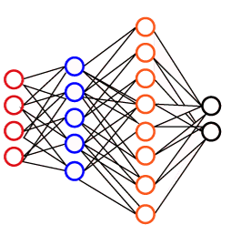
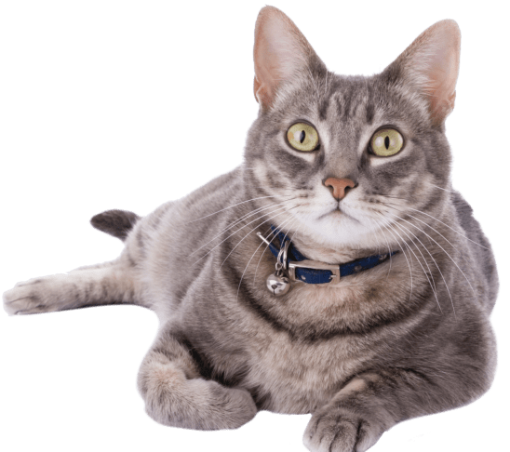
Convolutional Neural Network (CCN)
What if we provide the NN with features that can better represent the patterns in an image?
Features Extractions
CAT

Slide 21
Convolutional Neural Network (CCN)
What if we provide the NN with features that can better represent the patterns in an image?
CNN
CAT

Slide 22

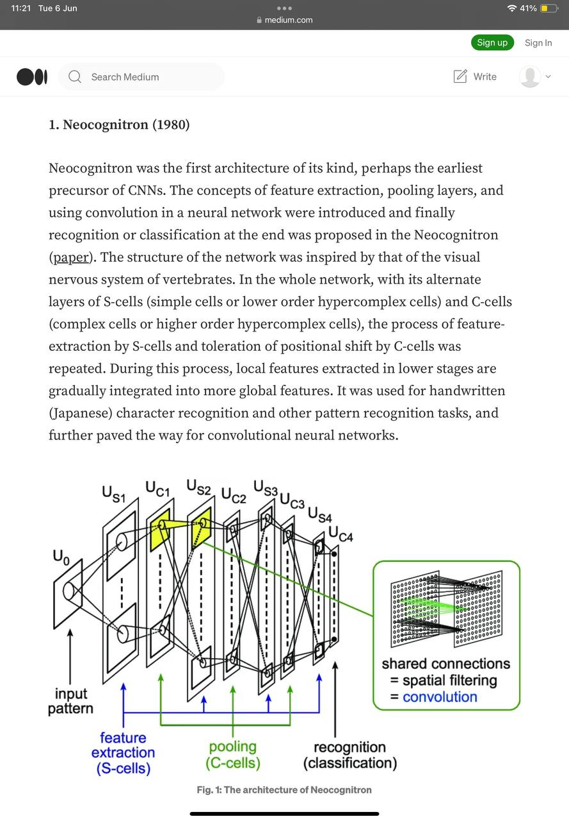
CNN – Pattern in Image (Neocognitron)

Slide 23
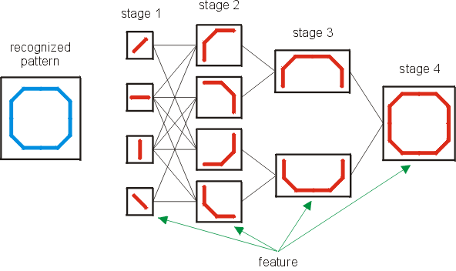
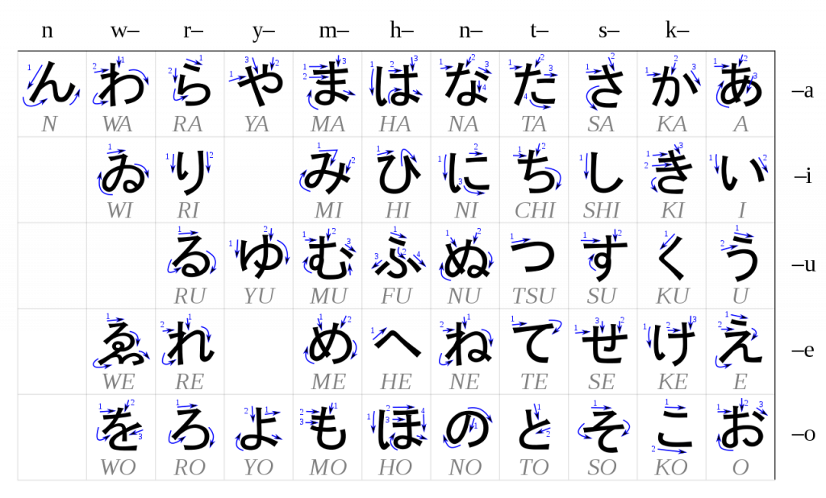
CNN – Pattern in Image (Neocognitron)

Slide 24
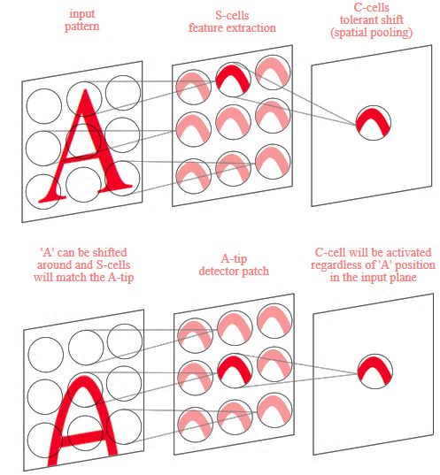
CNN – Pattern in Image (Neocognitron)

Slide 25
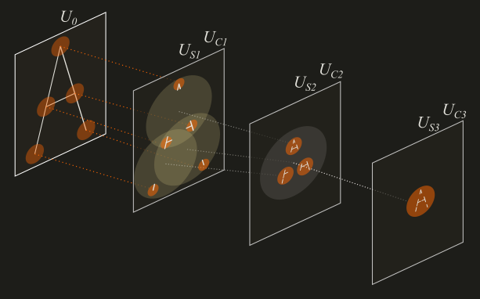
CNN – Pattern in Image (Neocognitron)

Slide 26
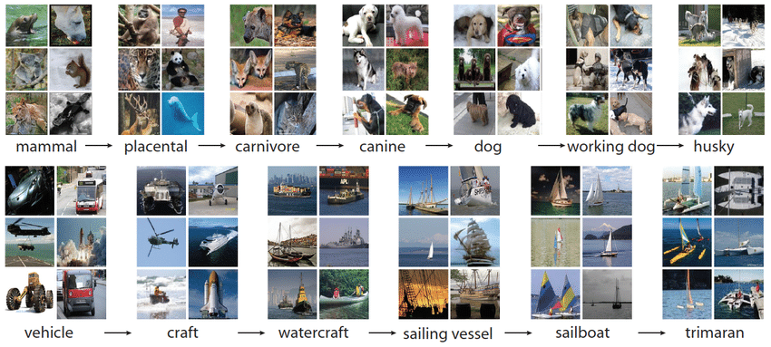
Convolutional Neural Networks (CNN)
ImageNet Database
Training: 1,281,167
Validation: 50,000
Testing: 100,000
Classes: 1,000
Humans error rate is 5%

Slide 27
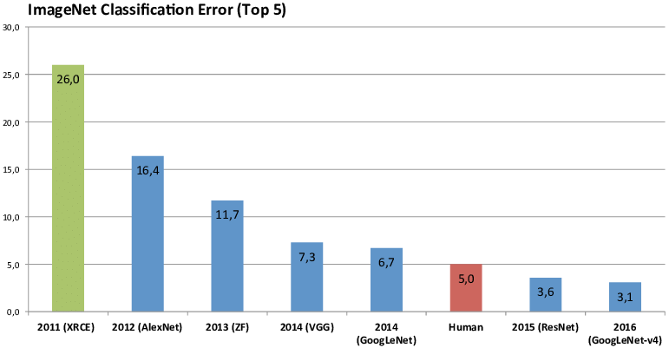
Convolutional Neural Networks (CNN)
First CNN-based Winner (AlexNet 2012)
It was a pioneer in enhancing the image classification task using CNN
Since 2012 all the winners were using CNN in their model.
CNN Features extraction technique
First CNN

Slide 28
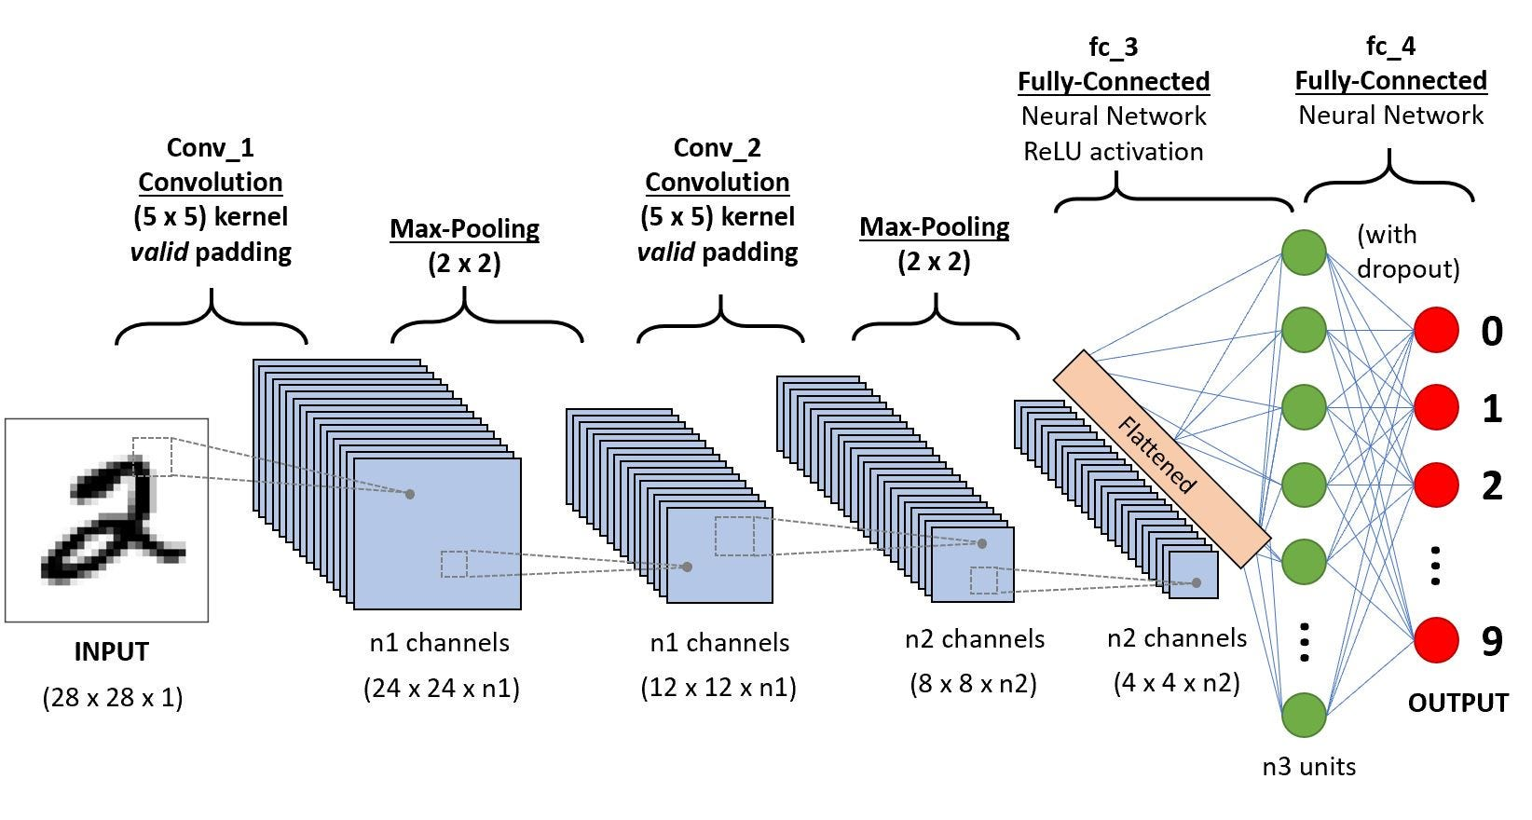
Convolutional Neural Networks (CNN)

Slide 29


Convolutional Neural Networks (CNN)
Kernel (Filter)
Kernels (Filters)
1 | 0 | 1
0 | 1 | 0
1 | 0 | 1

Slide 30
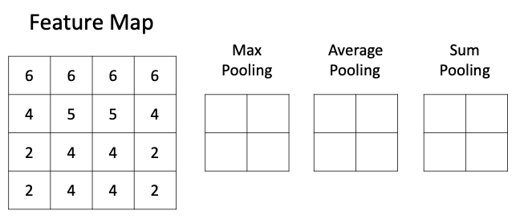
Convolutional Neural Networks (CNN)
Pooling

Slide 31
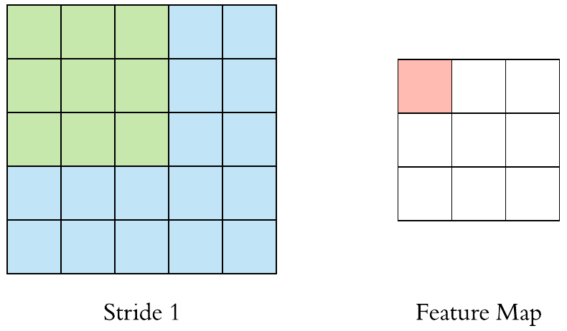
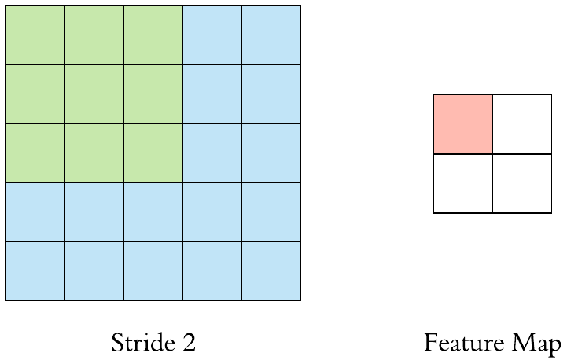
Convolutional Neural Networks (CNN)
Stride

Slide 32
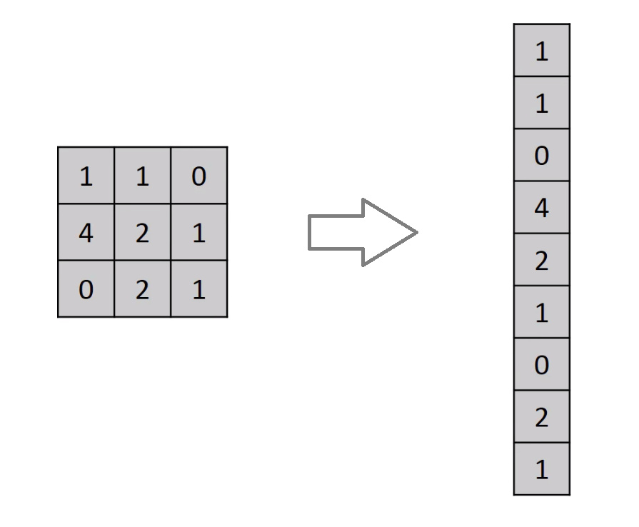
Convolutional Neural Networks (CNN)
Flatten
1
2
3
4

Slide 33
Convolutional Neural Networks (CNN)
The Architecture

Slide 34






The Process
Database
Read files
Process
Train
Evaluate
Test in RW

Slide 35
Outline
Terms
Define Computer Vision
State Some Applications of Computer Vision
Differentiate Between Image Classification and Objects Detection
Explain the Convolutional Neural Network (CNN)
Use CNN Algorithms
Create an Image Classification program
Computer Vision
Image Classification
Object Detection
Convolutional Neural Networks (CNN)
Kernel (Filters), Pooling, Stride, Flatten
Jupyter Notebook
01
02
03
04
05
06

Slide 36
Image classification - python

Slide 37

Image Classification - python
Image Classification using CNN
In this part, you will learn how to use python programming to create an image classifier based on CNN algorithms.
Learning Outcomes:
Use Jupyter Notebook for python programming
Explain the process of creating an ML model:
Load data
pre-process data
Create a CNN
Evaluate the model
Test the model
c) Build a simple UI to test the model

Slide 38



Python Code
GITHUB
V Env

Slide 39

Python Code
COLAB

Slide 40


Python Code

Slide 41
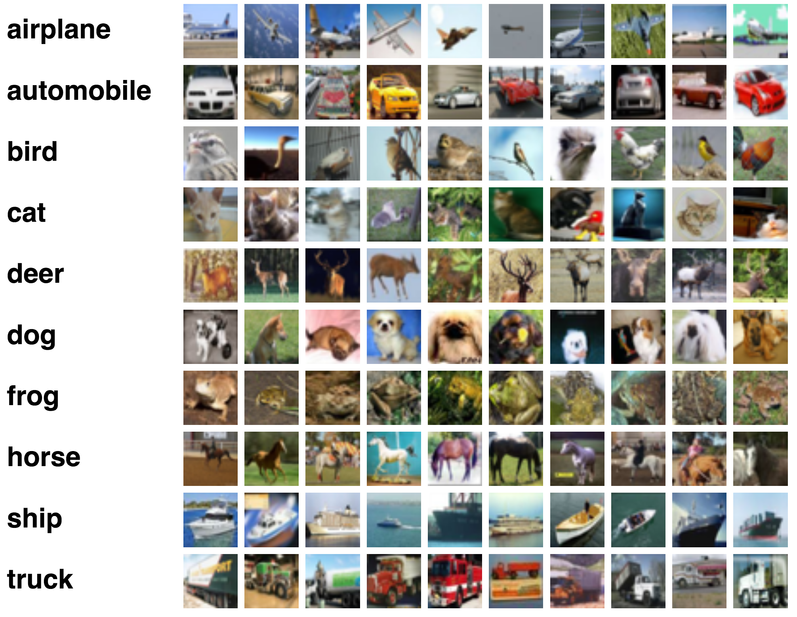
CIFAR-10 Dataset
The dataset that we will use for this task is the CIFAR-10 dataset
This dataset can be loaded from the keras python library
It consists of 60k 32x32 coloured images
It consists of 10 image categories (10 classes) – 6k images for each class

Slide 42
Dataset
Dataset - 10k Samples
70%
30%
Training – 7k samples
Testing – 3k samples
30%
Training – 5.6k
Validation – 1.4k
Testing – 3k samples
80% of training
20% of training

Slide 43

FC NN Digits recognition – COLAB

Slide 44
Outline
Terms
Define Computer Vision
State Some Applications of Computer Vision
Differentiate Between Image Classification and Objects Detection
Explain the Convolutional Neural Network (CNN)
Use CNN Algorithms
Create an Image Classification program
Computer Vision
Image Classification
Object Detection
Convolutional Neural Networks (CNN)
Kernel (Filters), Pooling, Stride, Flatten
Jupyter Notebook
01
02
03
04
05
06

Slide 45



Feedback
Confirmation
Clearance

Slide 46


This session will remain open. I will be available to take any further questions during this time. Please use the chat icon

Slide 47


Follow us
ese.ae
Ese_ae

